Slide 1
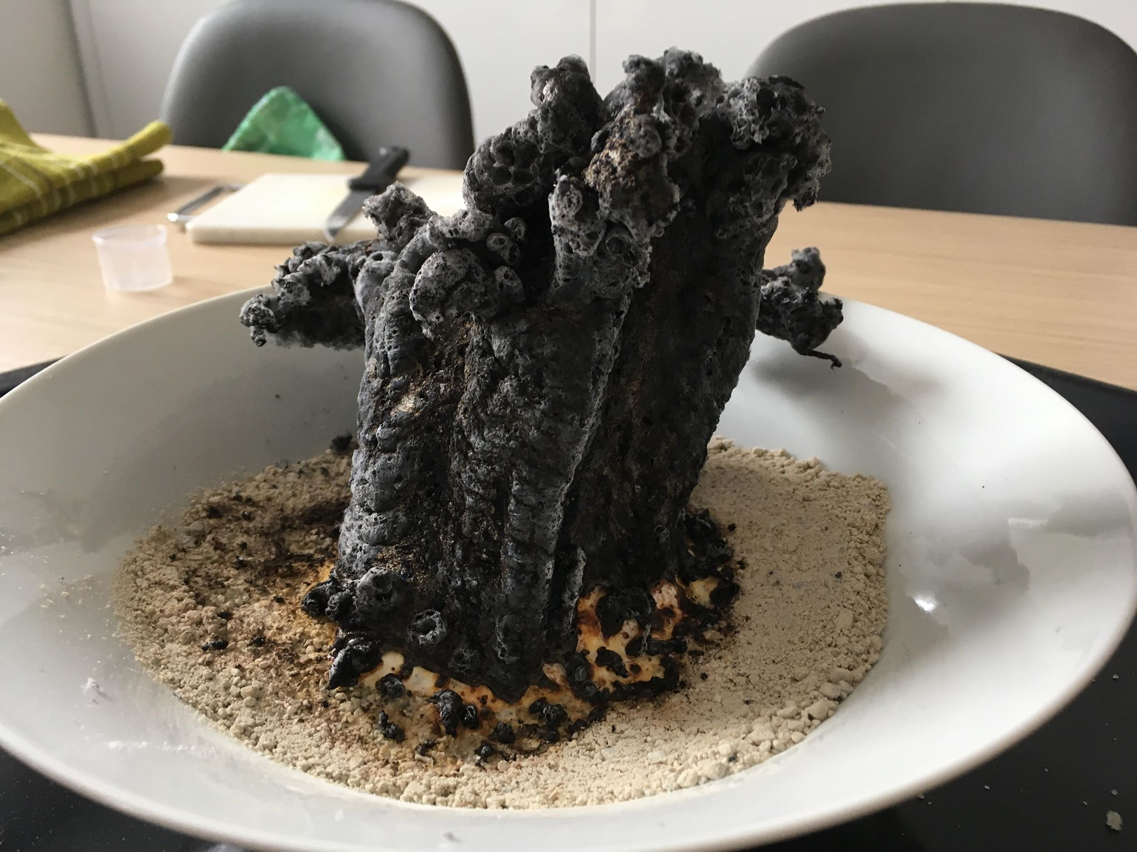
PHARAOH‘S SNAKE
Karin Grdadolnik
Sara Ferko
3.e.
Gimnazija Moste

Slide 2
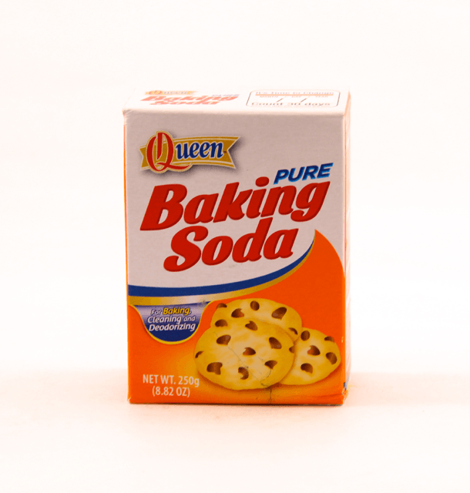
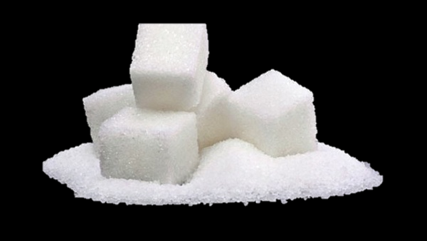
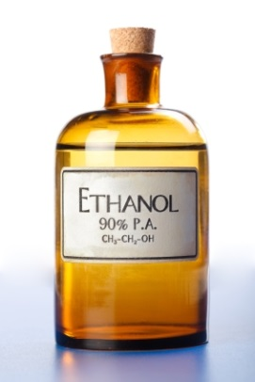
I. REAGENTS and AMENITIES
AMENITIES | REAGENTS
spoon glass bowl baking tray (for the foundation) kitchen scales lighter | baking soda (NaHCO_{3(s)}) sugar – sucrose (C₁₂H₂₂O_{11(s)}) ethanol (C₂H₅OH_{(aq)}) sand

Slide 3
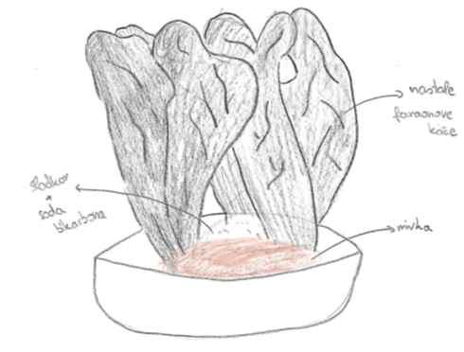
II. PROCEDURE of our experiment
1. We measured out amount of chemicals,
2. then we put sand in the bowl, and on it we put mixture of sugar and baking soda,
3. we spill ethanol around the mixture and lighted it with lighter.
Our sketch of the experiment

Slide 4
LINK TO OUR VIDEO ON YOU TUBE:
https://www.youtube.com/watch?v=G1HdQ1c45y0&t=3s

Slide 5
LINK TO KAHOOT:
https://play.kahoot.it/#/lobby?quizId=e6c40bb7-9977-4c85-8377-7dd1f890930b

